Slide 1
Digital Electronics
Lab *: Number System

Slide 2


Welcome to Digital Electronic Class

Slide 3

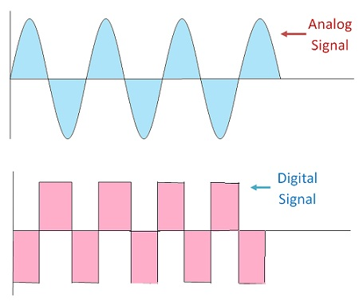
What is Digital Electronics?
The sub-branch of electronics which deals with digital signals for processing and controlling various systems and sub-systems

Slide 4
Digital System
Advantages
Easier Designing
Noise Immune
Information Storage is Simpler
High Accuracy And Precision
Programmable
Disadvantages
Expensive
Analog nature of Real World Entities

Slide 5
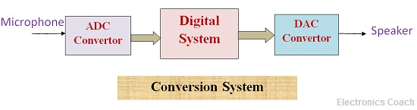
Digital to Analog and Analog to Digital Conversion

Slide 6
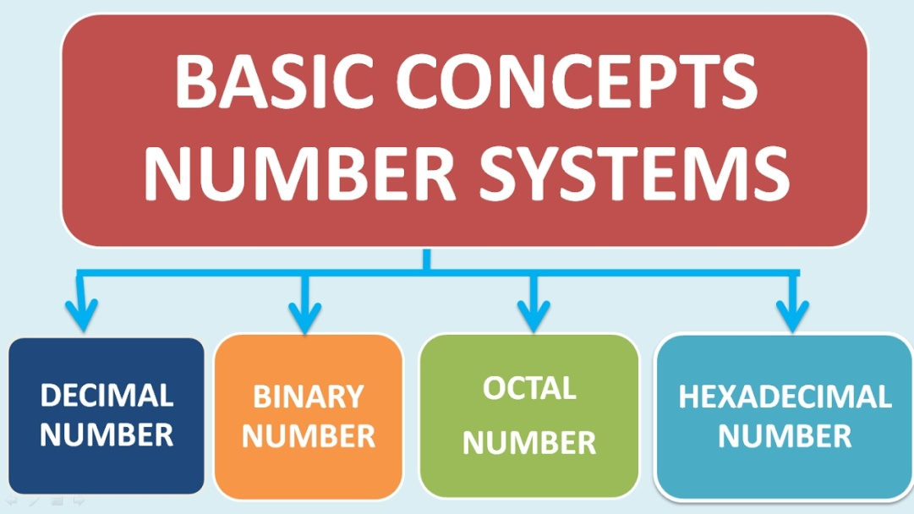
Number System
Number systems are the technique to represent numbers in the computer system architecture

Slide 7
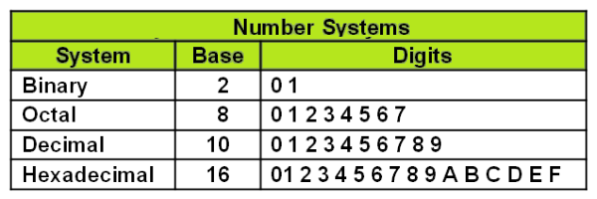
Number System

Slide 8
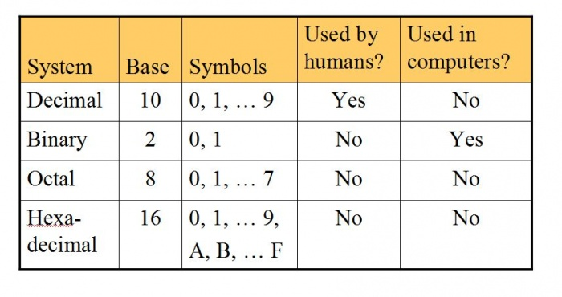
Number Systems

Slide 9
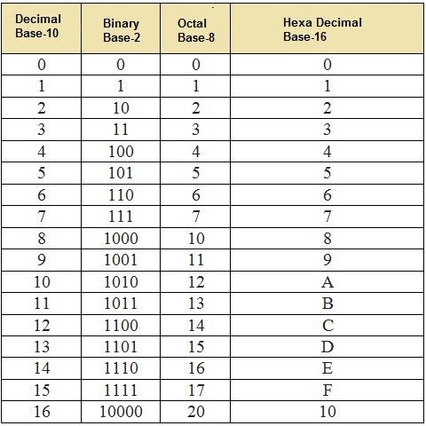
Number Systems

Slide 10

Thank You!

